Slide 1


















Slide 2
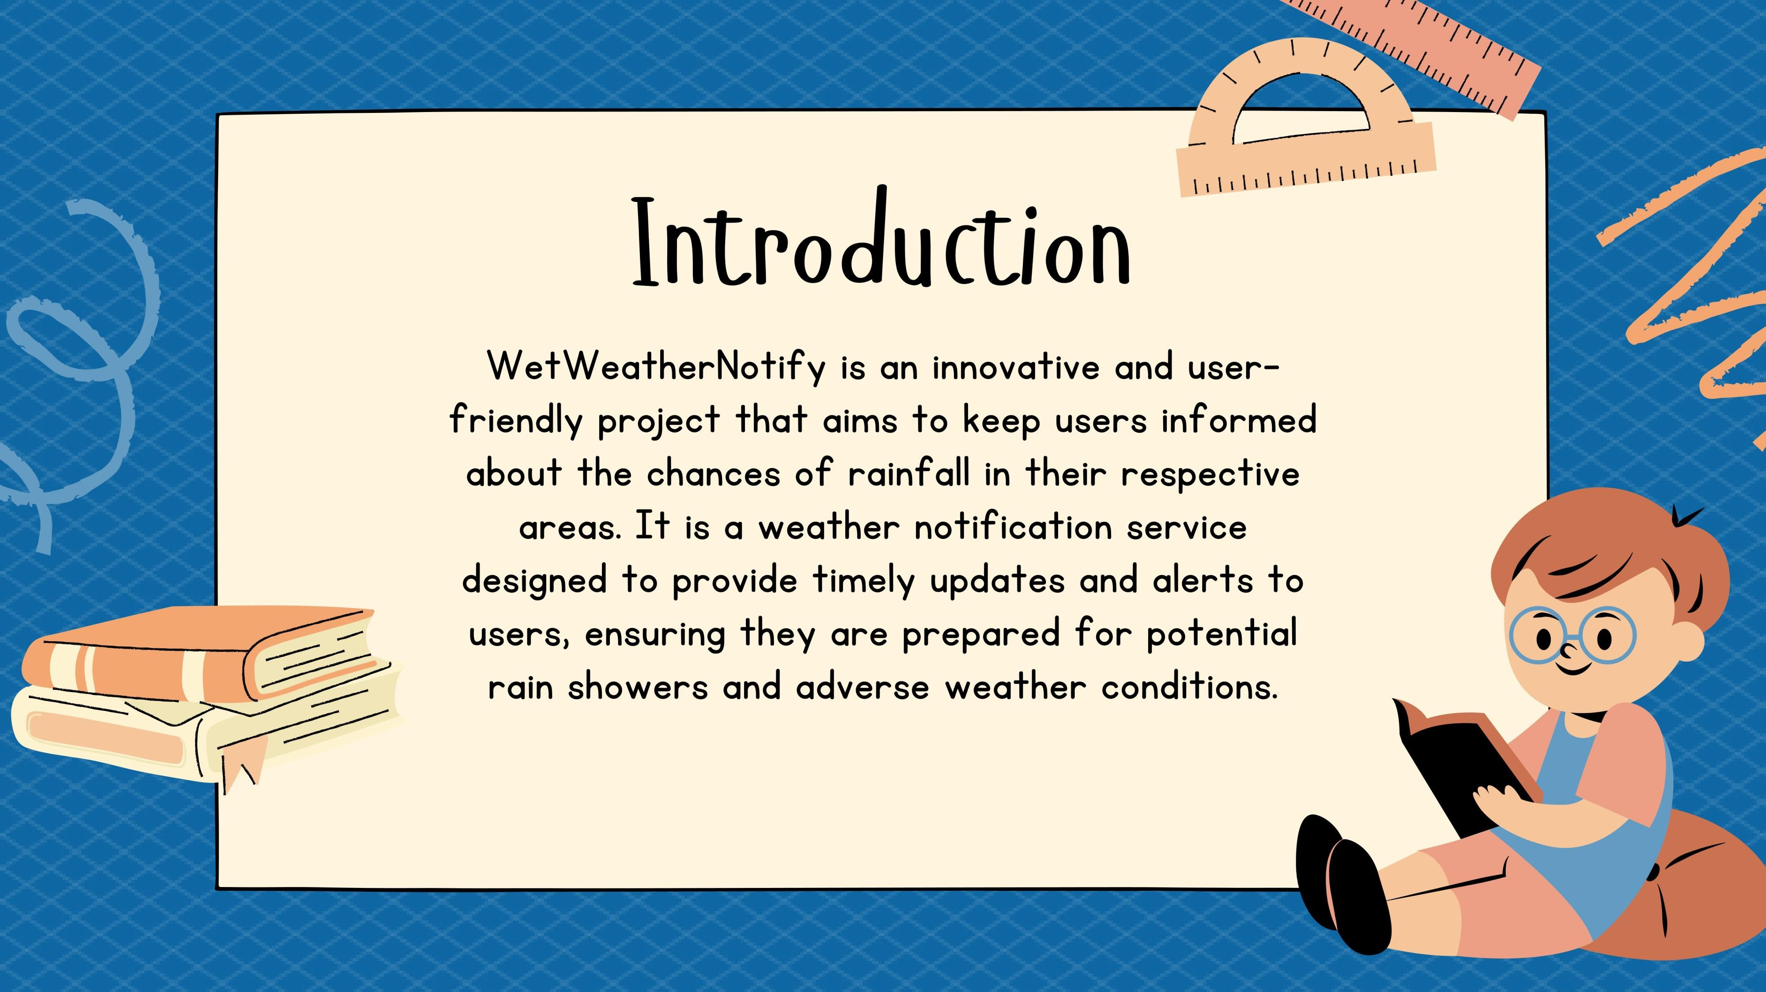

Slide 3
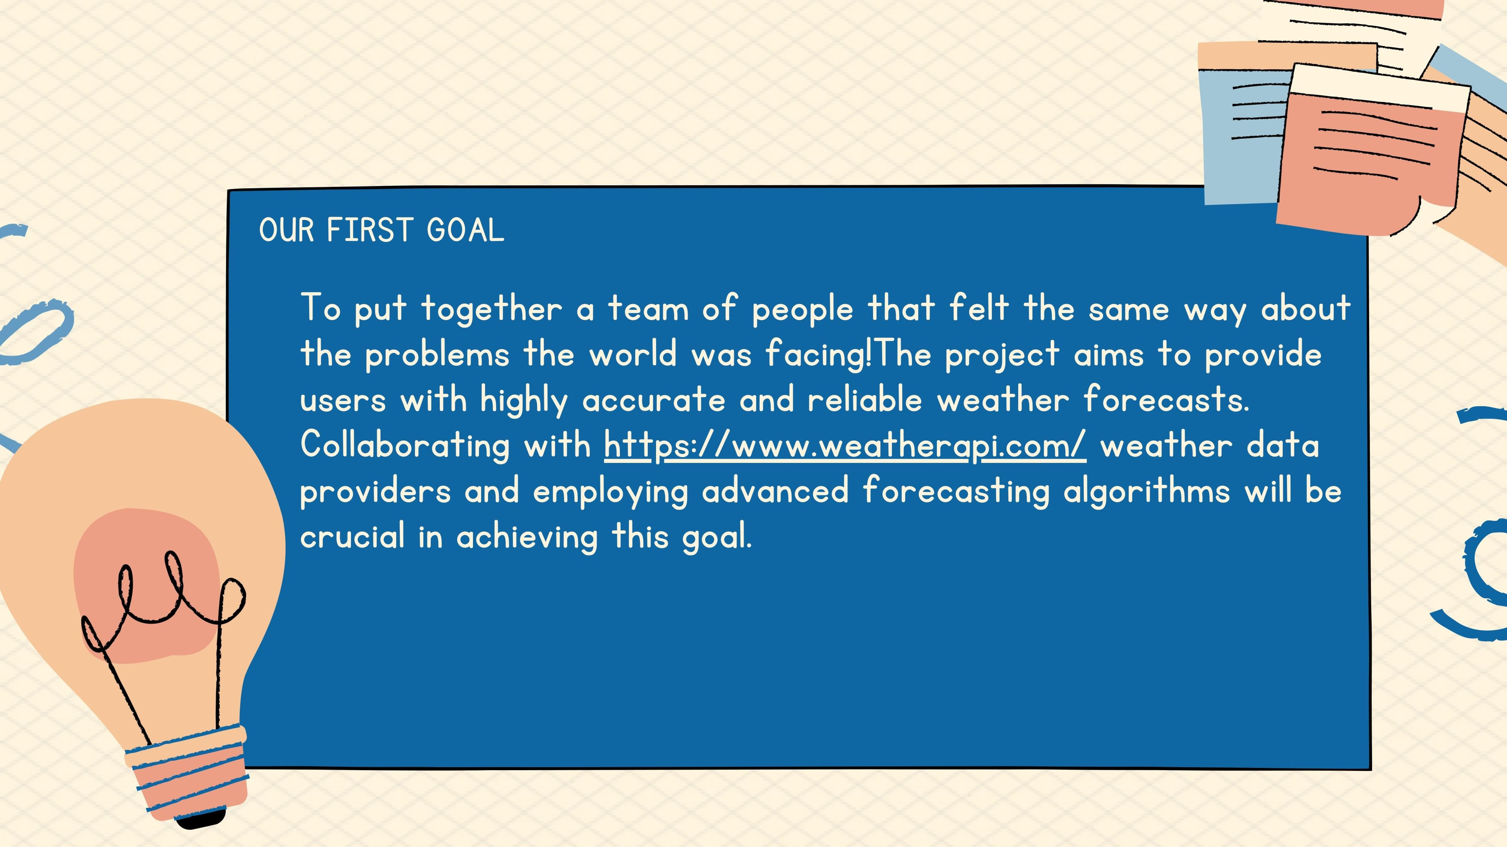
Our Goals

Slide 4

OUR SECOND GOAL
The project's primary focus is to guarantee timely email notifications for potential rainfall to users.
Our Goals
Emphasizing efficient data processing and delivery mechanisms, we aim to offer real-time updates. By prioritizing swift and accurate information dissemination, we aspire to keep users informed about imminent weather changes. This commitment

Slide 5
Our Goals
to timely communication ensures that individuals can proactively respond to evolving weather conditions, enhancing overall safety and
preparedness.

Slide 6
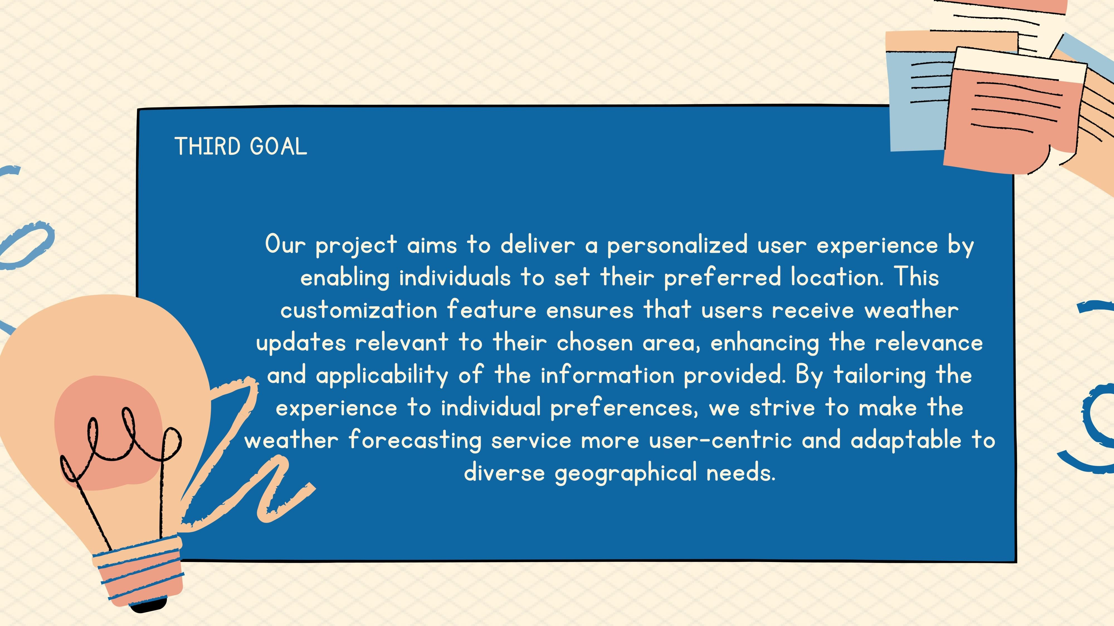

Slide 7
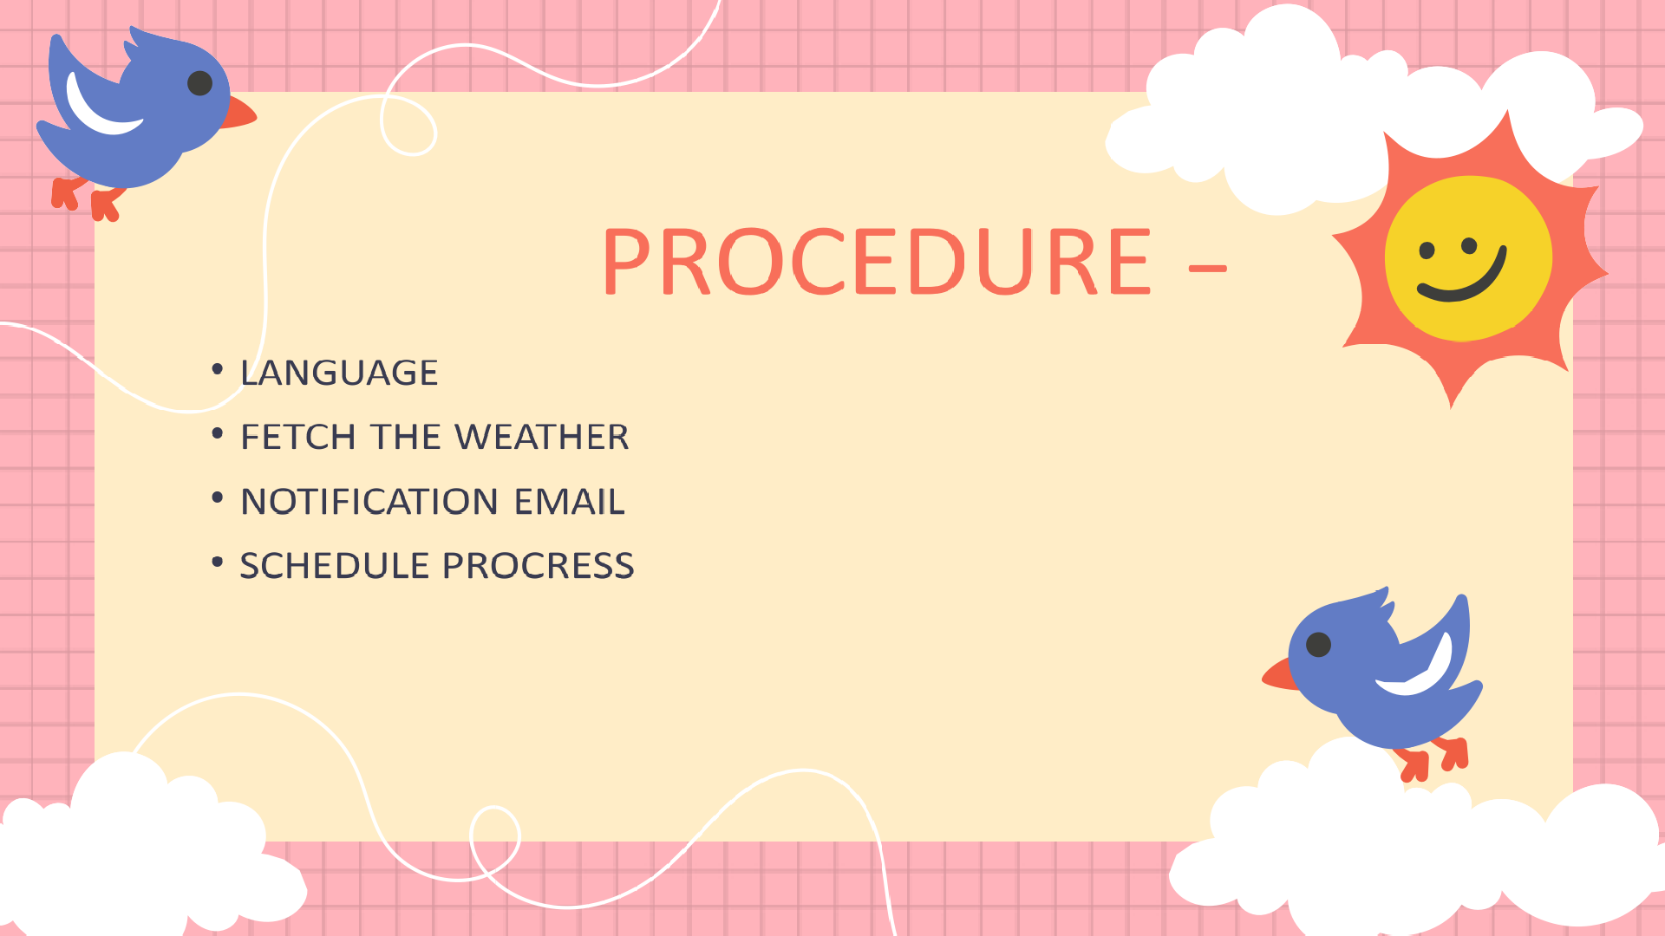
WORKING

Slide 8

Language
The project is based on the Python programming language.
Python is a versatile, high-level programming language known for its
readability and simplicity. Its clean syntax and dynamic typing facilitate rapid development across various domains, including web development, data
science, and artificial intelligence.
With a rich standard library and an active community, Python supports object-
oriented and procedural programming, making it accessible to beginners and powerful for experienced developers. Its interpreted nature, cross-platform compatibility, and extensive ecosystem of frameworks and libraries contribute to Python's widespread popularity and adoption in diverse fields.

Slide 9




































Slide 10






























Slide 11

Scheduling Process
The project employs the schedule library to meticulously time weather updates and notifications for clients. This ensures
timely information delivery without delays. Utilizing the library enables efficient coordination of data retrieval from
WeatherAPI.com and thread execution for email notifications, tailored to each client's designated location. With this
scheduling mechanism, the project seamlessly automates the process, providing clients with a hassle-free experience. Users receive pertinent weather information promptly, allowing them to plan activities with foresight and stay prepared for possible rain in their specific areas.

Slide 12
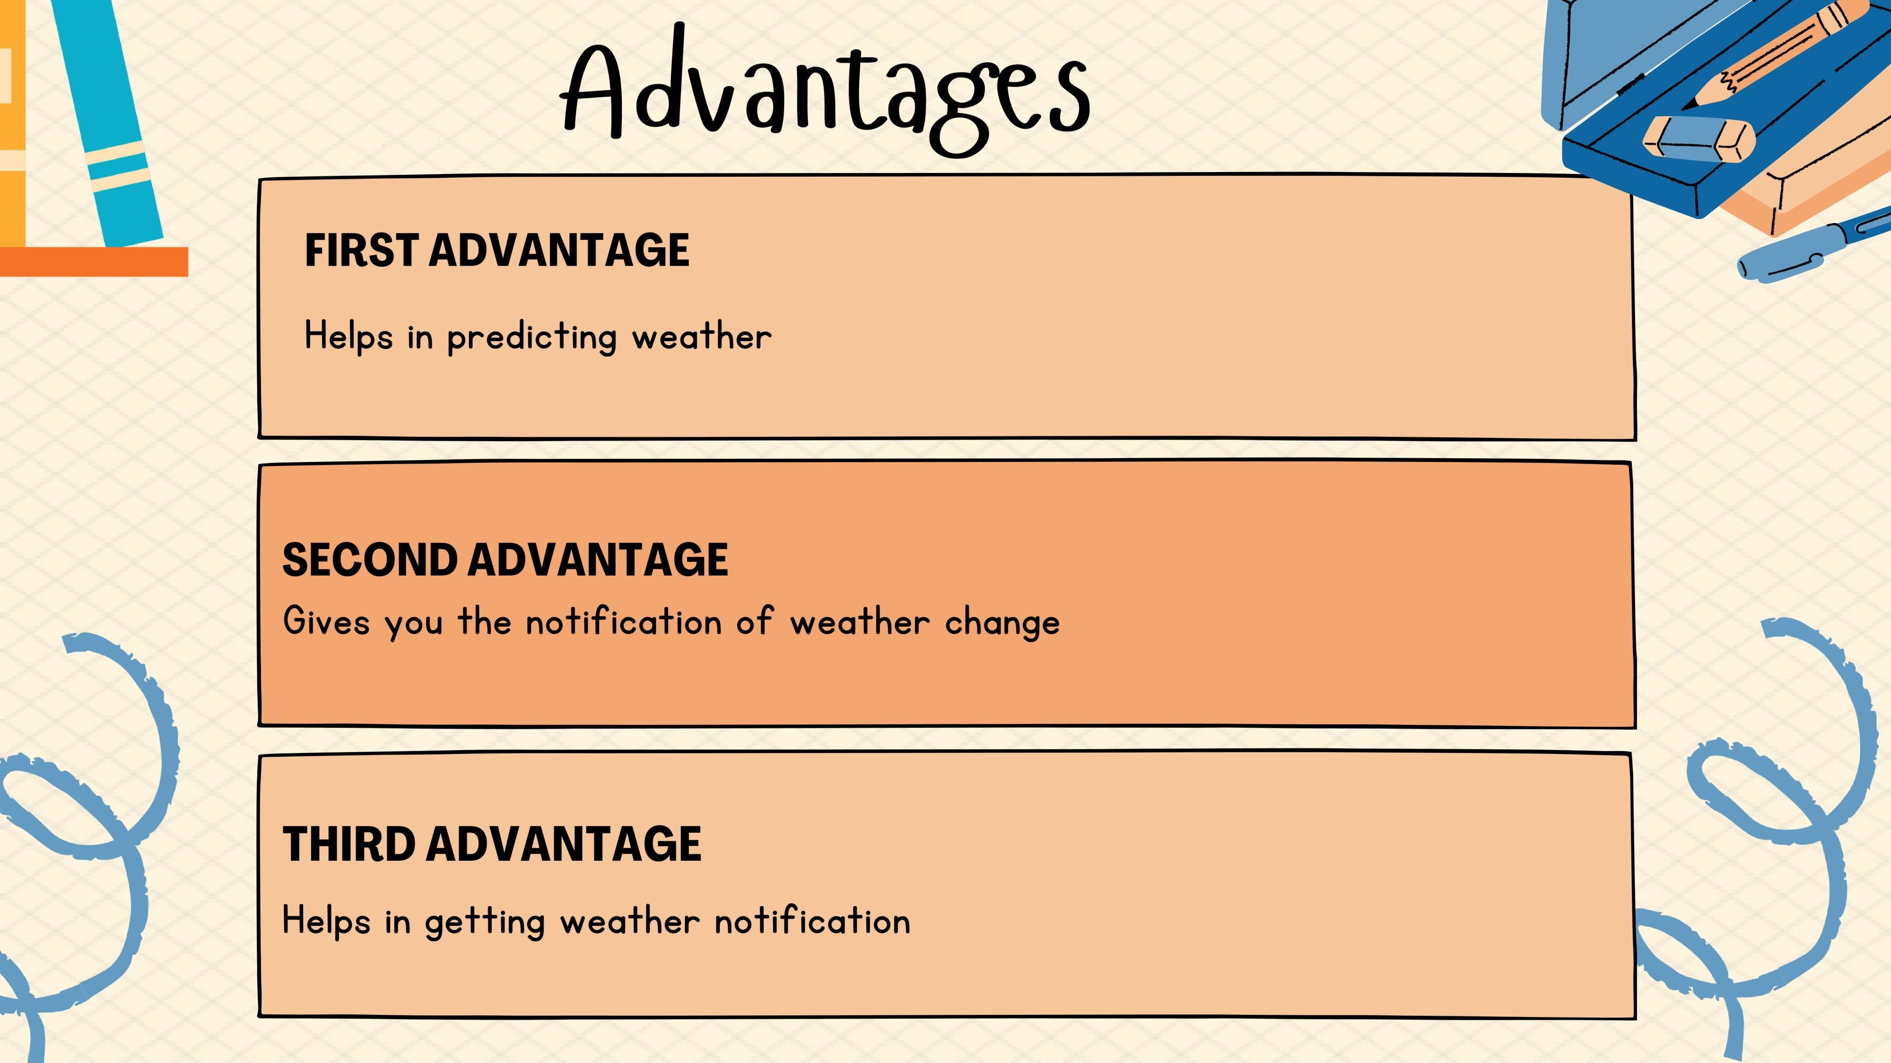

Slide 13















































Slide 14


